Slide 1
Data Quality Monitoring
DIME Continuing Education
Spring 2021
Prepared and Presented by Marc-Andrea Fiorina
mfiorina@worldbank.org

Slide 2
Introduction

Slide 3

Who are you?
4

Slide 4
What Does Data Quality Monitoring Mean?
You’re collecting data.
You want to collect “good” data.
Data quality monitoring allows you to collect “good” data.

Slide 5
All right. So what is “Good” Data?
Good data is uniquely identified.
Good data minimizes enumerator entry errors and respondent recall mistakes.
Good data has verified and confirmed suspicious outliers.
Data quality checks help us achieve this!

Slide 6
Data Quality Monitoring – Purpose
They catch data collection errors early
They ensure successful delivery of your data collection instrument (e.g., survey)
They provide an automatized process to track data collection progress
They’re the first building building block of your data analysis infrastructure
5

Slide 7
Data Quality Monitoring – Purpose
They catch data collection errors early
They ensure successful delivery of your data collection instrument (e.g., survey)
They provide an automatized process to track data collection progress
They’re the first building building block of your data analysis infrastructure
6

Slide 8
Data Quality Monitoring – Purpose
They catch data collection errors early
They ensure successful delivery of your data collection instrument (e.g., survey)
They provide an automatized process to track data collection progress
They’re the first building building block of your data analysis infrastructure
7

Slide 9
Data Quality Monitoring – Purpose
It catches data collection errors early
It ensures successful delivery of your data collection instrument (e.g., survey)
It provides an automatized process to track data collection progress
It’s the first building building block of your data analysis infrastructure
8

Slide 10
Data Quality Monitoring – Key Components
Workflow
Division of responsibilities; Check / Replacement / Correction protocols
Instrument
e.g., Dashboard, Graphs, Tables
Checks
Enumerators, Outliers, Logic Issues, etc.
Tracking
Evaluating data collection progress
Data Infrastructure
Folder and scripts setup
9

Slide 11

Checks

Slide 12
Checks – What to Monitor
Enumerator Checks
Average survey duration
Number of surveys completed
Don’t know/refused to respond rates
Survey consent rates
11

Slide 13
Checks – What to Monitor
Community-Level Checks
Number of surveys completed
Data collection progress
12

Slide 14
Checks – What to Monitor
Logic Checks
Pre-specified possible data errors
Any check that can be made using a true/false statement
e.g., Profit is larger than revenue
13

Slide 15
Checks – What to Monitor
Outlier Checks
Check for values of a variable that fall outside of a certain range
e.g., any value that is 3 standard errors above or below the mean of the variable
14

Slide 16
Checks – What to Monitor
Descriptive Statistics
Keep an eye on key outcome variables with a small descriptive table
e.g., mean, median, first and third quartiles, standard deviation
15

Slide 17
Checks – What to Monitor
Observation Tracking
A table consisting of every respondent with some tracking indicators
e.g., complete survey, incomplete reason, needs replacement
16

Slide 18
Checks – What to Monitor
Back Checks
Supplemental surveys for randomly-chosen data collection subjects
Check for :
Enumerator compliance
Accuracy of outlier values
Possible difficult questions to be changed in survey instrument
17

Slide 19
Checks – Key Insight
The content of the check you are creating should determine the structure of your dataset.
For example, to create enumerator checks, you should aim to create a dataset in which:
Each row corresponds to an enumerator
Each column corresponds to a data quality indicator (e.g., number of surveys completed, average survey duration, etc.)
18

Slide 20
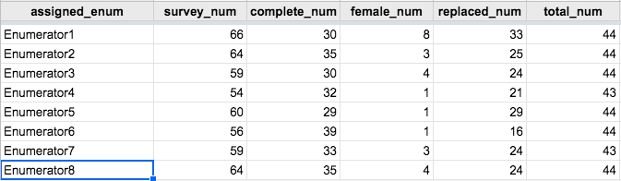
Checks – Key Insight
19

Slide 21

Instrument

Slide 22
Instrument – How to Monitor Data
Your goal in creating a data monitoring instrument should be to streamline the process as much as possible
Think of ways to efficiently output the information you need to check your data: e.g., graphs, tables, or dashboards
21

Slide 23
Instrument – How to Monitor Data
Your goal in creating a data monitoring instrument should be to streamline the process as much as possible
Think of ways to efficiently output the information you need to check your data: e.g., graphs, tables, or dashboards
22

Slide 24
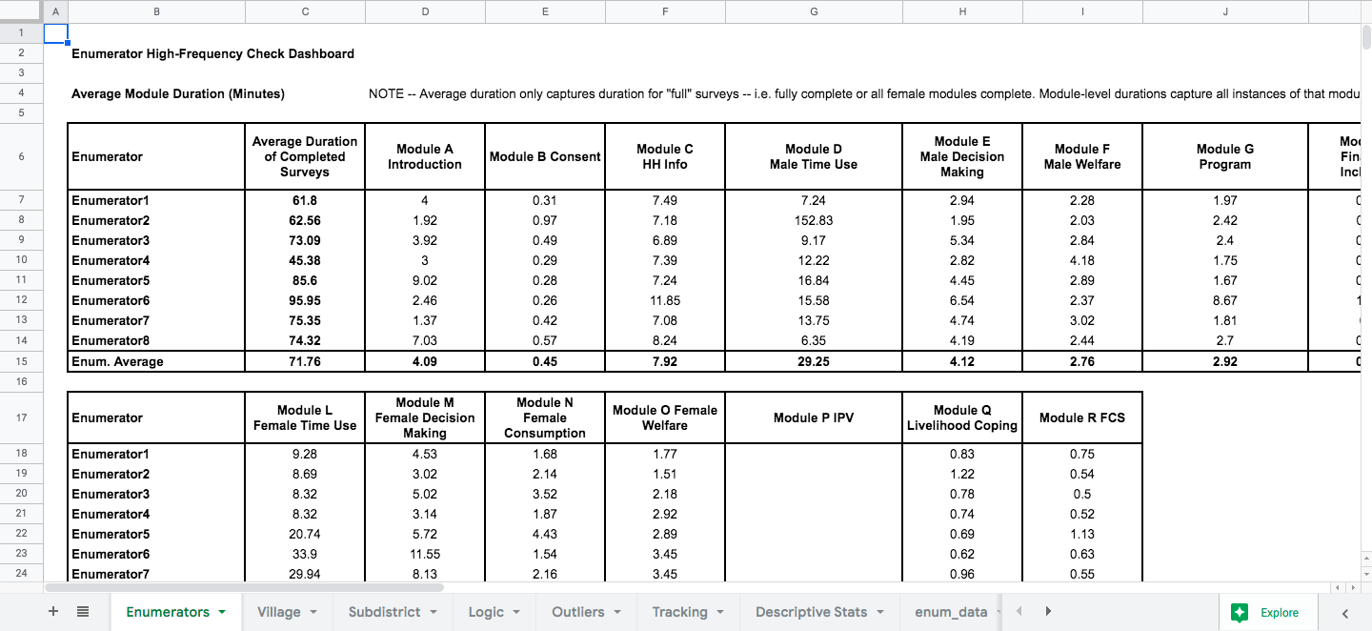
Instrument Example – Google Sheets Dashboard
23

Slide 25
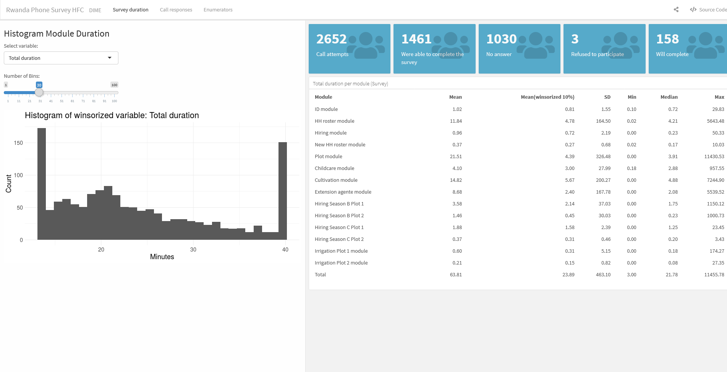
Instrument Example – Shiny App
23

Slide 26
Instruments – Dashboard Software Selection
It is also perfectly fine to use Microsoft Excel to output your checks. Whatever works best!
Pick a tool that’s easiest for sharing with all relevant stakeholders (PIs, country office partners, etc.)
I like Google Sheets or a Shiny app because they are easy to share with research assistants, field coordinators, survey firms, or PIs
25

Slide 27
Instrument –Excel/Google Sheets Export Tips
Stata
excel import/excel export
R
openxlsx
googledrive/googlesheets4
Python
pandas.dataFrame.to_excel
pygsheets
26

Slide 28
Instrument – Tips to Create a Dashboard
The key to exporting survey data to a formatted spreadsheet is to:
Export the dataset to a “data” sheet (e.g., “enum_data”)
Use Excel/Google Sheets formulas to draw from the “data” sheet into a “presentation” sheet (e.g., “Enumerators”)
27

Slide 29
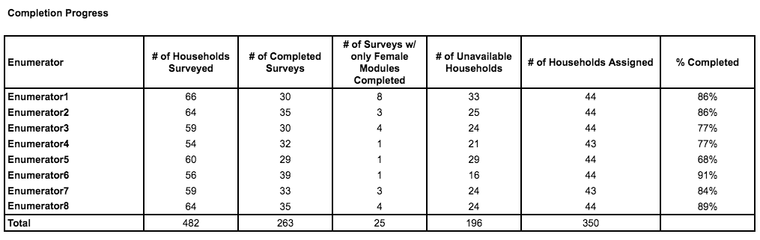
Instrument – Tips to Create a Dashboard
The key to exporting survey data to a formatted spreadsheet is to:
Export the dataset to a “data” sheet (e.g., “enum_data”)
Use Excel/Google Sheets formulas to draw from the “data” sheet into a “presentation” sheet (e.g., “Enumerators”)
28

Slide 30

Workflow

Slide 31
Checks – What to Monitor
Division of responsibilities – Who does what?
Who downloads the data and runs the quality checks? Is it the research assistant? Is it the field coordinator?
Who makes corrections to the data if needed?
How and when do participants in the data monitoring process communicate? How do time zones affect this?
30

Slide 32
Workflow – Things to Consider
Correcting data
In the event of an error, at what stage is data corrected?
How will you keep track of these corrections?
31

Slide 33
Workflow – Things to Consider
Enumerator accountability
How will you communicate and confirm mistakes or data discrepancies with enumerators?
What happens if data monitoring shows that an enumerator consistently makes errors, or is rushing through questions, or even is entering fake data?
32

Slide 34
Workflow – Things to Consider
Replacements
What happens if a survey needs to be replaced?
Are there backup households/respondents from which to select a replacement?
How is this communicated to the field team? How will you keep track of replacements?
33

Slide 35
Workflow – Things to Consider
Encryption
You will be regularly downloading data with personally identifiable information (PII)
How will you keep the data safe? How will you encrypt it? Will you de-identify it before running the data monitoring scripts?
34

Slide 36
Workflow – Things to Consider
Back checks
When will you run back checks and with how many respondents? Will they be in person or over the phone?
What do you do if back checks show many inaccuracies for an enumerator? What about if they show that respondents aren’t understanding a question?
35

Slide 37
Workflow – Things You’ll Need
A Data Process Workflow
Explains responsibilities, data download process, scripts used, links to dashboards, etc.
A Corrections Protocol
Explains corrections method, categories of corrected errors, etc.
A Replacements Protocol
Explains method of detection and communication of replacement need and tracks replaced/replacement observations
An Encryption Protocol
Explains encryption practices followed by the team, as well as instructions on how to follow them
A Back Checks Protocol
Explains when and how back checks will be conducted, and what the process will be to make use of their findings
36

Slide 38

Tracking

Slide 39
Tracking Opportunity
Data quality checks represent a perfect opportunity to set up an automated data collection tracking system for your project
After all, you will be outputting information into your dashboard at the enumerator or village level. Why not at the respondent level?
38

Slide 40
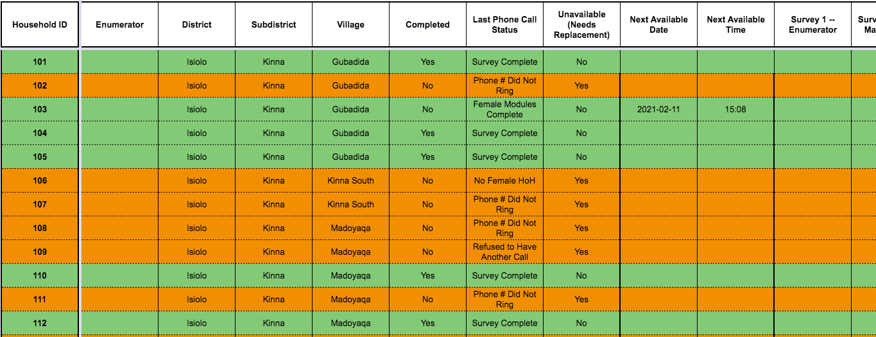
Tracking Opportunity
39

Slide 41

Data Infrastructure

Slide 42
Data Infrastructure
As you set up your data monitoring process, you will need to consider how to organize the data and scripts you’ll use
This the perfect time – before data collection starts – to use this as the building block for your future data cleaning and analysis folder structure
41

Slide 43
Data Infrastructure – Suggested Folder Setup
Shared Folder
Baseline Data
Deidentified Data
Clean, Constructed,...
Encrypted Data
Identified Data
Data Quality Check Data
GitHub Repository
Baseline Code
Cleaning, Construction,…
Encrypted Code
Data Import Scripts
Data Quality Check Scripts
Deidentification Scripts
Encryption Scripts
42

Slide 44
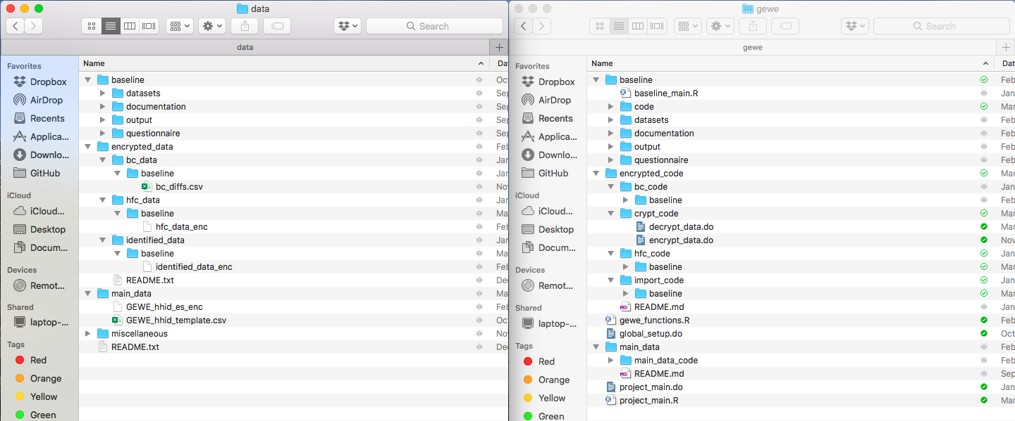
Data Infrastructure – Example
Dropbox
GitHub
43

Slide 45
Conclusion

Slide 46
Key Components Reminder
Workflow
Division of responsibilities; Check / Replacement / Correction protocols
Instrument
e.g., Dashboard, Graphs, Tables
Checks
Enumerators, Outliers, Logic Issues, etc.
Tracking
Evaluating data collection progress
Data Infrastructure
Folder and scripts setup
45

Slide 47
Final Message
Every project is unique and will have different constraints on what you can/should do in terms of data quality monitoring.
Hopefully, this presentation gave you an idea of what data quality checks can look like and serve as a blueprint or inspiration for your checks!
… Any Questions?
46

Slide 48
Thank you!
Resources:
DIME Analytics – https://www.worldbank.org/en/research/dime/data-and-analytics
DIME Analytics Data Handbook – https://worldbank.github.io/dime-data-handbook
DIME Analytics Research Standards – https://github.com/worldbank/dime-standards
DIME Wiki – https://dimewiki.worldbank.org
High Frequency Checks – https://dimewiki.worldbank.org/wiki/High_Frequency_Checks
Data Maps – https://dimewiki.worldbank.org/wiki/Back_Checks
Data Quality Assurance Plan – https://dimewiki.worldbank.org/wiki/Data_Quality_Assurance_Plan
47

Slide 49
Thank you!
Resources:
Exporting Data from Stata to Microsoft Excel: https://www.stata.com/features/overview/excel-import-export
Export Data from R to Google Sheets: https://googlesheets4.tidyverse.org/articles/googlesheets4.html
Export Data from Python to Google Sheets: https://github.com/nithinmurali/pygsheets
48

